Slide 1
Welcome
This is Muni and Team

Slide 2

Student Management System — Lovable AI Web App
A concise overview for school administrators, IT coordinators, and educators evaluating a web-based student management solution built with Lovable AI.
Notes:
1

Slide 3
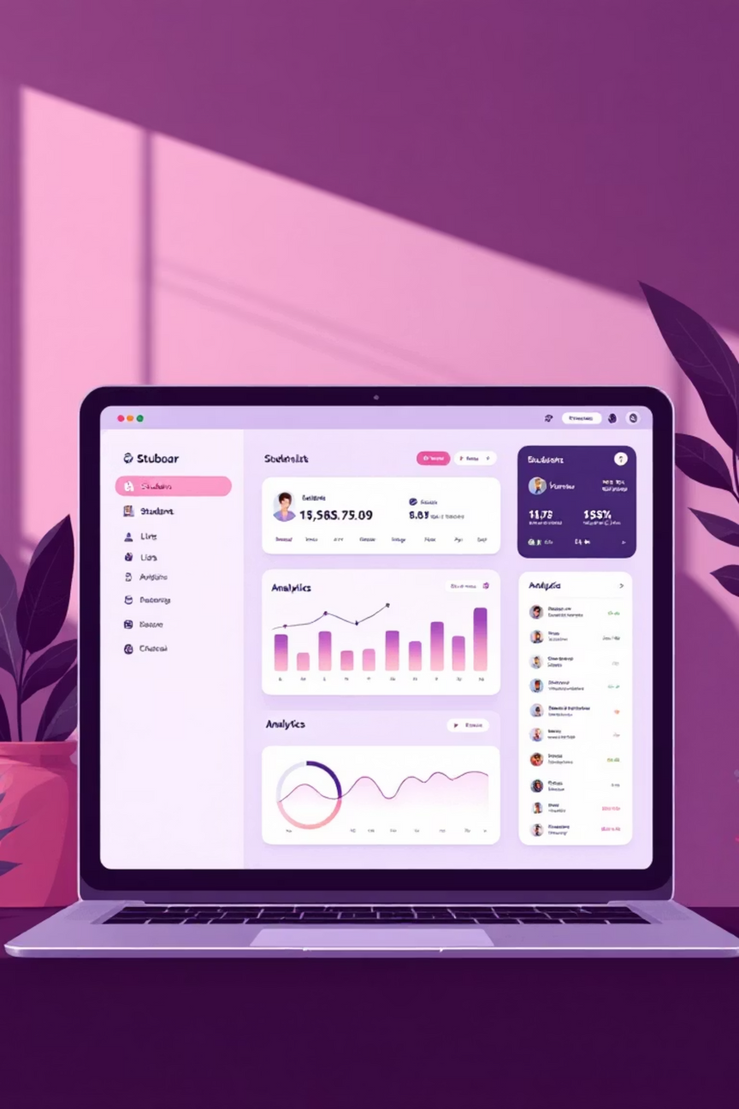

What It Is
The Student Management System is a web-based platform — built with Lovable AI — that centralizes student records, attendance, marks, fee management, and timetables. Designed for school teams who need accuracy, speed, and simple workflows.
Built for browsers and responsive on mobile; focuses on clear data-entry paths and quick access for staff.
Notes:
2

Slide 4

Problem Statement
Current challenges
Manual data entry creates errors and administrative delays
No single source of truth for attendance, grades, and fees
Fragmented tools increase workload for teachers and staff
Notes:
3

Slide 5

Proposed Solution
Introduce a web-based Student Management System that automates records, streamlines attendance and grading, tracks fees, and generates timetables — all through a clean, role-based interface for admins, teachers, and parents.
Emphasis: reduce manual tasks, centralize data, and enable secure role-based access.
Notes:
4

Slide 6
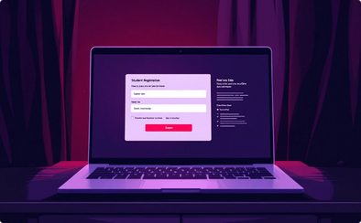

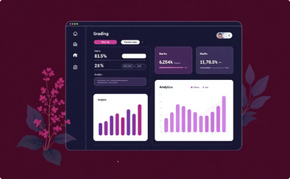
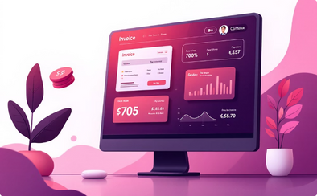
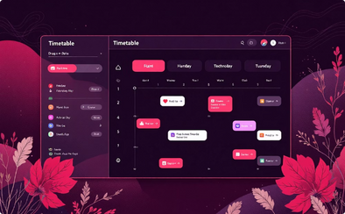
Key Features
1. Student Registration
2. Attendance Management
3. Marks Management
4. Fee Tracking
Fast intake forms, bulk imports, and unique IDs for reliable records.
Daily attendance, reports, and absence tracking with exportable logs.
Flexible grade entry, weighted assessments, and per-student reports.
Invoice generation, payment status, and simple reconciliation tools.
5. Timetable Generation
Auto-generation, conflict detection, and printable schedules for staff & students.
Notes:
5

Slide 7


System Architecture
The architecture balances modern frontend ergonomics with scalable backend services and secure storage.
Frontend: HTML, CSS, JavaScript, Bootstrap — responsive, accessible UI
Backend: Python Flask with Lovable AI hooks for automation and intelligent workflows
Database: MySQL for relational data; optional Firestore for realtime features
Design supports modular integrations (SMS/email, payment gateways, single sign-on).
Notes:
6

Slide 8
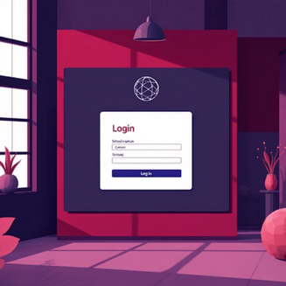
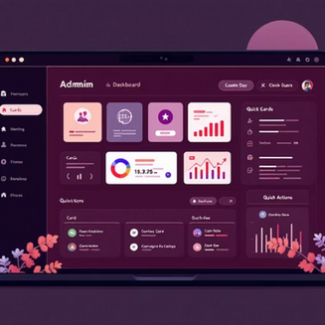
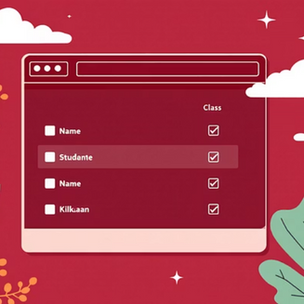
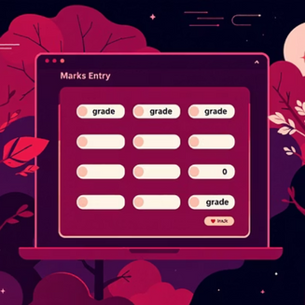
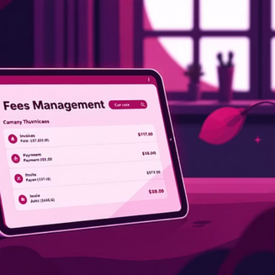
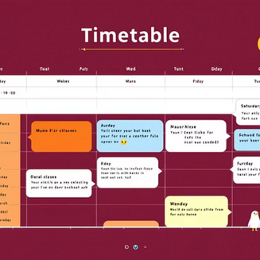
Demo & Screenshots
Live demo includes Login, Dashboard, Attendance, Marks, Fees, and Timetable pages. Try the demo to experience workflows and permissions.
Demo URL: student-management-system-project.lovable.app/auth
Notes:
7

Slide 9




Benefits for Schools
Efficiency
Security
Automates repetitive tasks — saves staff hours each week.
Role-based access and secure authentication protect student data.
Mobile Responsive
Real-time Tracking
Teachers and parents can view information on any device.
Immediate visibility into attendance, grades, and fees.
Notes:
8

Slide 10




Roadmap — Future Enhancements
AI Attendance (Face Recognition)
Analytics Dashboard
Automated check-in to reduce teacher burden and improve accuracy.
Visual insights for student performance, trends, and intervention flags.
Automated Fee Reminders
Mobile App Integration
Scheduled notifications via SMS and email to improve collections.
Native apps for offline use, push notifications, and parent engagement.
Prioritization focuses on high-impact features that reduce admin time and increase engagement.
Notes:
9

Slide 11

Conclusion & Next Steps
Simplify. Secure. Scale.
The Lovable AI Student Management System streamlines academic operations with automation, centralized data, and a responsive design tailored for schools.
Request a pilot deployment
Data migration plan and staff training
Custom integrations and timeline
Thank you — Developed as a mini project using free AI tools. Contact the demo site to begin a pilot.
Notes:
10

